Slide 1
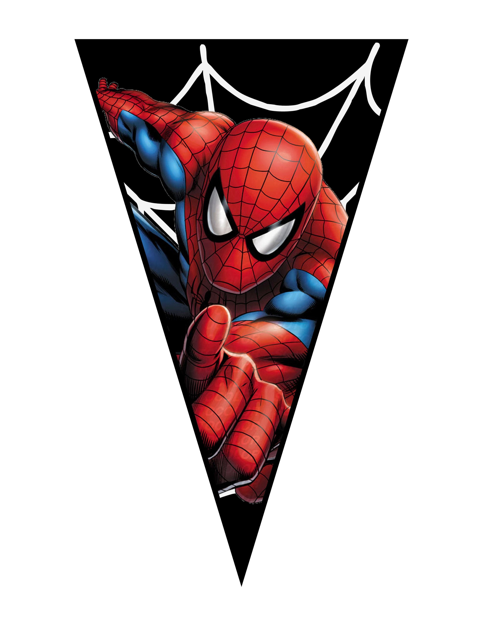
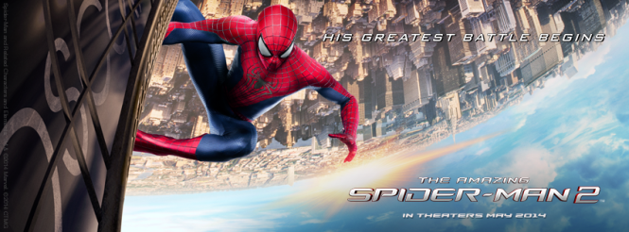

MY FAVORITE MOVIE
SPIDER - MAN

Slide 2
Spider - Man
"Spider-Man" begins with the story of a young man named Peter Parker, who lives in New York City. He is an ordinary teenager, struggling with bullying at school and social challenges. However, his life takes a dramatic turn when he is bitten by a radioactive spider.
After this incident, Peter discovers he has gained incredible abilities: he can crawl up walls, has enhanced strength and reflexes, and possesses a "spider-sense" that alerts him to danger. Realizing that with great power comes great responsibility, he decides to use his new abilities to protect others and fight against crime.

Slide 3
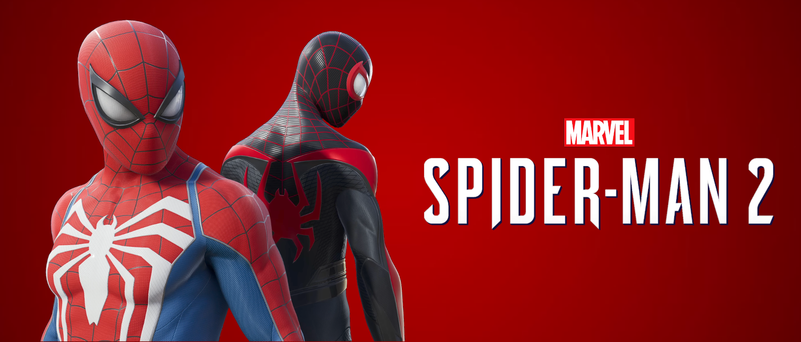
How Peter Parker Became Spider-Man
After being bitten by a radioactive spider during a school field trip, Peter Parker undergoes a dramatic transformation. Initially, he experiences strange new abilities, such as enhanced strength, agility, and the ability to stick to walls.
At first, Peter is excited about his powers and uses them for personal gain, participating in wrestling matches to earn money. However, after a traumatic incident where he allows a thief to escape, leading to the death of his Uncle Ben, Peter learns a powerful lesson about responsibility.
Haunted by guilt, he adopts the persona of Spider-Man, dedicating himself to fighting crime and protecting the innocent. With the iconic suit and web-shooters he invents, he becomes a symbol of hope in New York City, embracing his role as a hero.

Slide 4
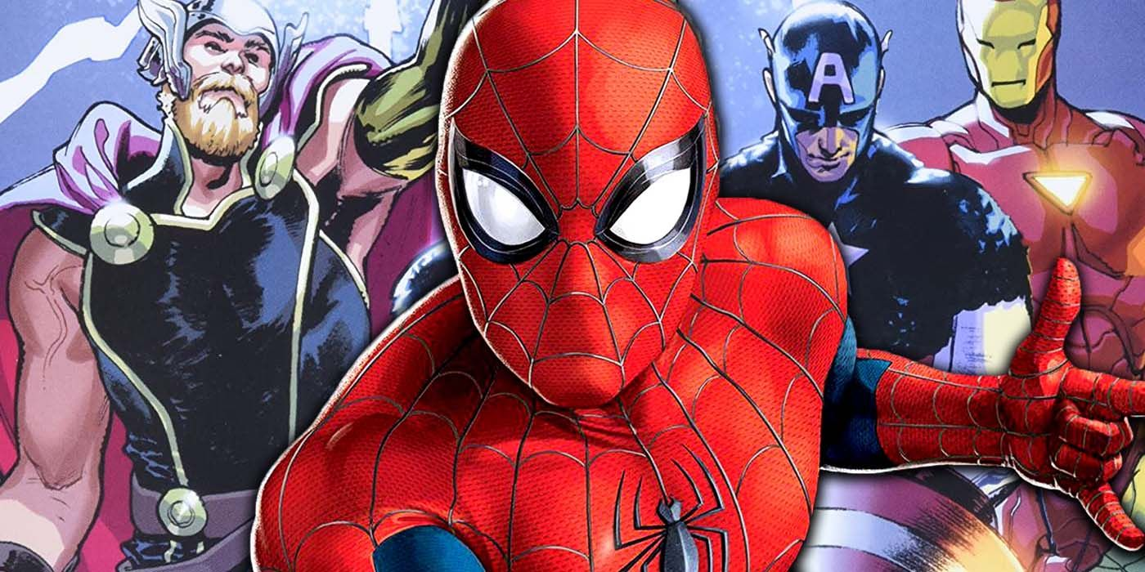
How Spider-Man Joined the Avengers
Spider-Man first interacts with the Avengers in the film "Captain America: Civil War". In this movie, Tony Stark (Iron Man) discovers Peter Parker and recruits him to join the conflict surrounding the Superhero Registration Act. Tony helps Peter develop a new suit equipped with advanced technology.
Following the events of "Civil War," Spider-Man continues to team up with the Avengers. In "Avengers: Infinity War"and "Avengers: Endgame“ he fights alongside them against Thanos, solidifying his place in the team. His relationships with Tony Stark and other Avengers, like Black Widow and Thor, help him grow as a hero and understand the importance of teamwork.

